Slide 1

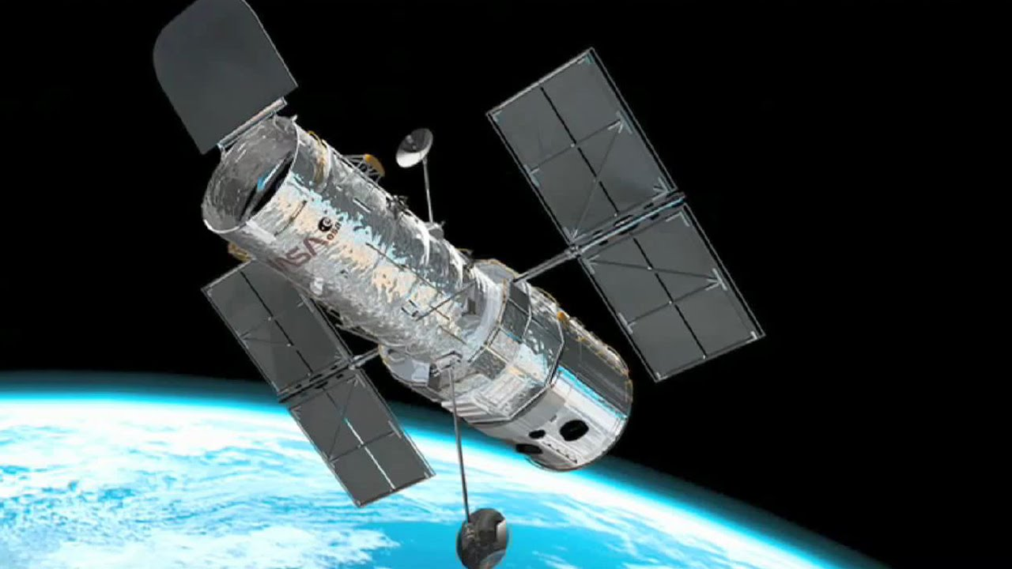
Blind Deconvolution of Images
Glasses For Your Telescope
Hayden Brown

Slide 2


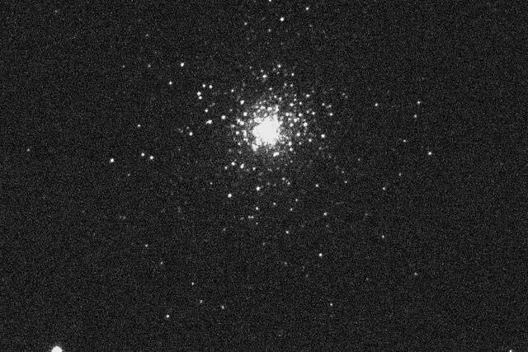
Images and blurring
Many important every day applications deal with images.
They are often an ideal and natural way to measure and view the world:
Photography
Astronomy
Medical imaging (tomography, ultrasound)
Selfies ?
In each case there is an underlying object or scene we wish to observe
the original or ‘true’ image is the ideal representation of the observed scene.
But the process of observing is never perfect. Uncertainty is always introduced in the measurements:
Blurring
Noise
Other degradations in the recorded images
Blurring
Noise

Slide 3
Blurring and Noise
In photography,
Blurring Long exposure times increase the risk of camera shake.
Lens aberrations can create blur across images in particular for wide apertures.
Noise CCD camera noise.
Image noise becomes noticeable in low-light conditions.
In astronomy and remote sensing,
Blurring Atmospheric turbulence blurs images.
Badly manufactured mirrors (here’s looking at you Hubble Space Telescope ! ).
Noise Imaging faint /distant objects means low SNR.
Thermal noise.

Slide 4

Introducing: Blind Image Deconvolution
A family of computation/mathematical techniques that allow images to be recovered from one (or many) ‘blurred‘ images when the blurring process is unknown.
Initial work in this area started in the 1970s. Various techniques have surfaced to tackle the problem.
So, what’s in a name?
Blind
no a priori knowledge of the parameters/models describing the convolution transfer function
Image
involving imagery
Deconvolution
reversing the blurring of an image by reversing the transfer function to get back to the true image.

Slide 5

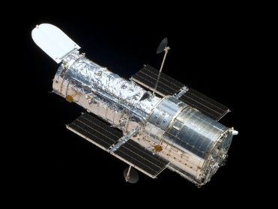
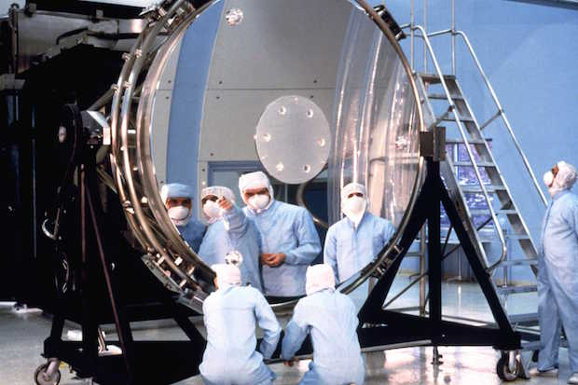
Story Time – Hubble Space Telescope
Hubble Space Telescope was launched into Low Earth Orbit in 1990.
2.4m diameter mirror capable of deep space imaging outside of the earth’s atmosphere.
After a number of hurdles to it being deployed, when it was finally launched it was found that the main mirror had been ground incorrectly preventing proper operation of the telescope.
The mirror had been ground too flat, 2.2 micron too flat causing spherical aberration i.e. where all light of the mirror does not focus to the same point.
Bright objects could be imaged, but the telescope was largely useless for fainter (more distance) objects.
?

Slide 6
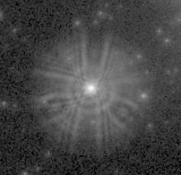
Story Time – Hubble Space Telescope

Slide 7
Story Time – Hubble Space Telescope
Images of point sources (stars) were spread out over a radius of more than one arc second. Instead of having a PSF* spanning <0.1 arc second.
1 arc minute = ¹/₆₀ of a degree
1 arc second = ¹/₃₆₀₀ of a degree
( * we’ll talk about PSFs shortly )
Luckily, the telescope was designed to be serviced in space.
after a further five missions, the telescope was repaired and upgraded (fitted with optics to reverse the aberration).
However, as the source of the errors was relatively well understood, the aberration was deemed to be stable and that meant signal processing techniques such as Blind Image Deconvolution could be used to correct for the phenomenon

Slide 8
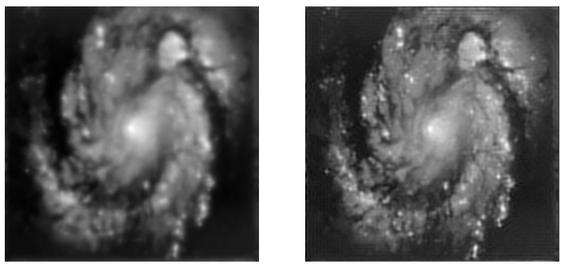
Story Time – Hubble Space Telescope
Hubble image with known aberration characteristics
Gibbs
Oscillations due to boundary
Hubble image before deconvolution
Hubble image after deconvolution

Slide 9
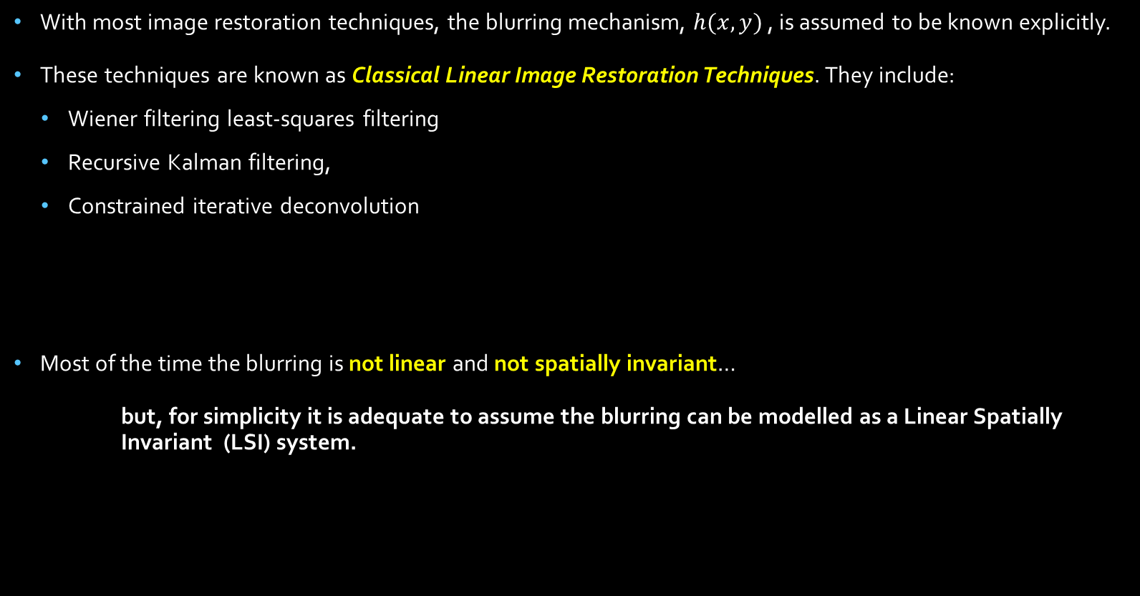
Image Restoration Techniques
With most image restoration techniques, the blurring mechanism, $h(x,y)$ , is assumed to be known explicitly.
These techniques are known as Classical Linear Image Restoration Techniques. They include:
Wiener filtering least-squares filtering
Recursive Kalman filtering,
Constrained iterative deconvolution
Most of the time the blurring is not linear and not spatially invariant…
but, for simplicity it is adequate to assume the blurring can be modelled as a Linear Spatially Invariant (LSI) system.

Slide 10
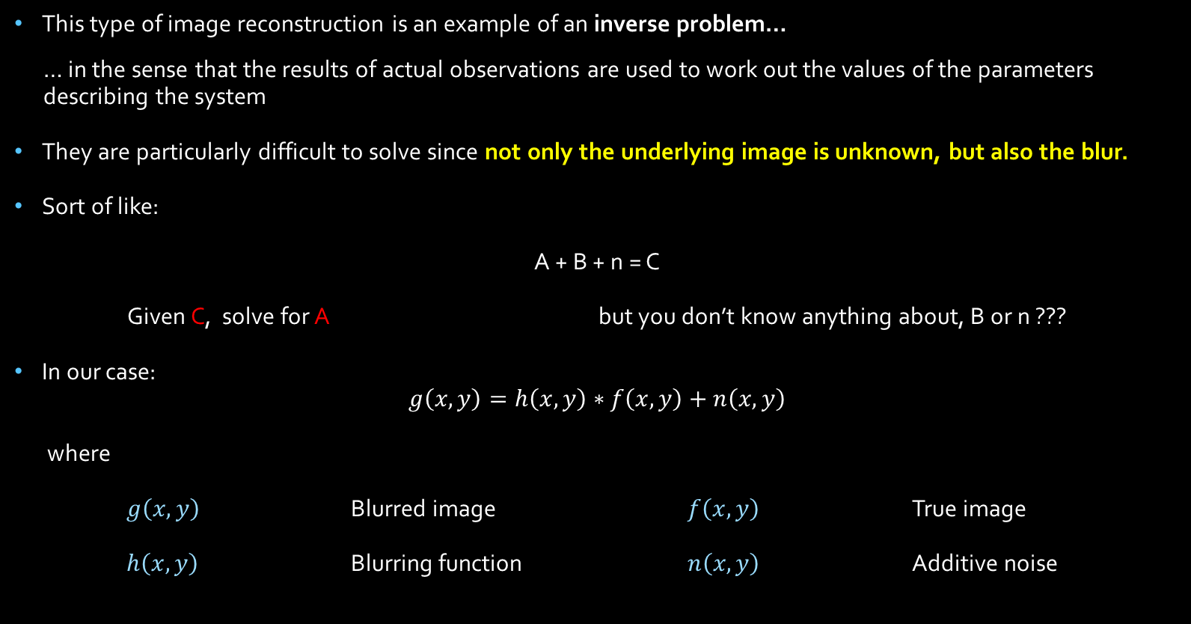
Image Restoration Techniques
This type of image reconstruction is an example of an inverse problem…
… in the sense that the results of actual observations are used to work out the values of the parameters describing the system
They are particularly difficult to solve since not only the underlying image is unknown, but also the blur.
Sort of like:
A + B + n = C
Given C, solve for A but you don’t know anything about, B or n ???
In our case:
$$g\left(x,y\right)=h\left(x,y\right)∗f\left(x,y\right)+n\left(x,y\right)$$
where
$g\left(x,y\right)$ Blurred image $f\left(x,y\right)$ True image
$h\left(x,y\right)$ Blurring function $n\left(x,y\right)$ Additive noise

Slide 11
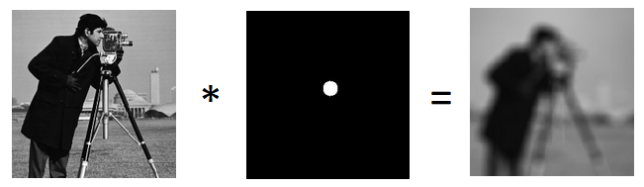
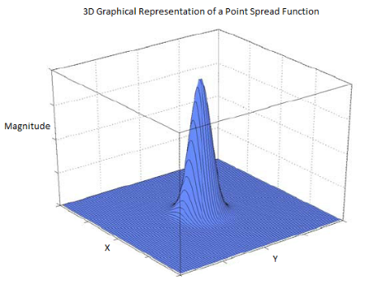
Introducing the Point Spread Function
In normal deconvolution of imagery the Point Spread Function (PSF) is the impulse response of the blurring mechanism.
If the blurring mechanism is thought of as a filter, the point spread function is the transfer function describing how the blurring process affects the true image.
True Image
Point Spread
Function
Observed
Image

Slide 12
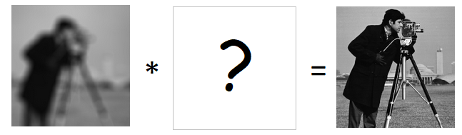
Introducing the Point Spread Function
In a nutshell, the PSF describes how the energy of one point (pixel) is smeared additively and spatially across the image.
In many cases, the point spread function is a large matrix with one value for each pixel.
In essence, the deconvolution process is identifying the inverse of the point spread function so that it can reverse the effects of the blurring process.
Observed
Image
Inverse PSF
Image
Estimate

Slide 13
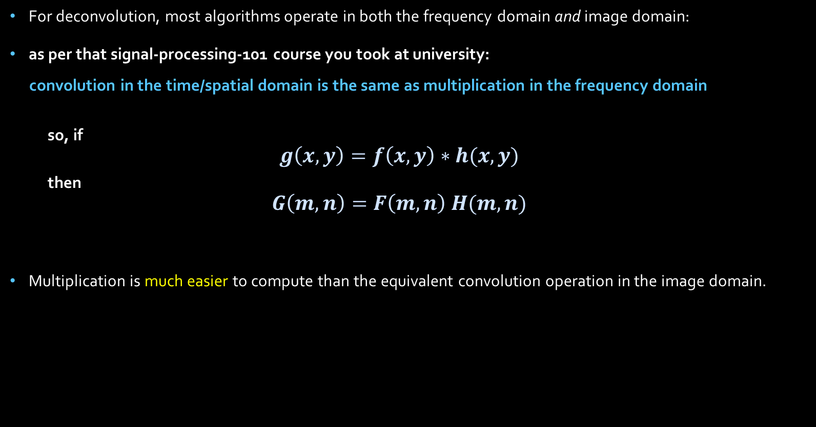
Introducing the Point Spread Function
For deconvolution, most algorithms operate in both the frequency domain and image domain:
as per that signal-processing-101 course you took at university:
convolution in the time/spatial domain is the same as multiplication in the frequency domain
so, if
$$g\left(x,y\right)=f\left(x,y\right)∗h(x,y)$$
then
$$G\left(m,n\right)=F\left(m,n\right) H(m,n)$$
Multiplication is much easier to compute than the equivalent convolution operation in the image domain.

Slide 14
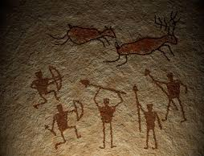
Introducing the Point Spread Function
The trouble with Point Spread Functions, is that measuring them directly is often :
too costly
too slow
too practically difficult
too dangerous
or, simply that the opportunity to measure the PSF has passed
So, techniques (such as Blind image deconvolution) are a viable way to estimate the PSF, without going to all the trouble of measuring them …
.. and the techniques can be applied backwards to legacy images!

Slide 15
Image Restoration Techniques
Image restoration does not have the properties of a well-posed problem:
According to the Hadamard criteria, a well-posed problem is one that:
Has a solution.
Has a unique solution.
Has a solution that depends continuously on the parameters or input data (natural order to things).
The number of unknown parameters, as well as the properties of the parameters makes the problem very challenging.
A small perturbation in the given data produces a large deviation in the resulting solution.
The direct inverse of the transfer function describing the blurring mechanism usually has large magnitudes at high frequencies, so excessive amplification of noise at these frequencies will occur.

Slide 16
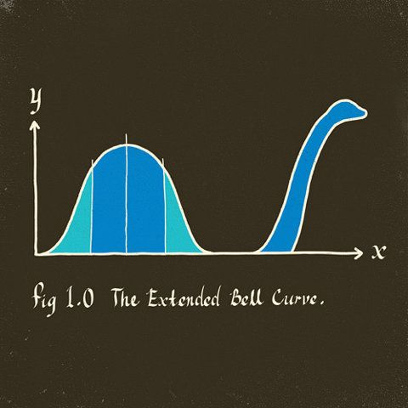
Image Restoration Techniques
Typically assumptions need to be made to fill in the blanks with respect to the problem in order to have any decent chance of solving it.
In any case, no matter how good the algorithm is, getting back to the true image is impossible due to the addition of noise.
After all, noise is a random process that can only be modelled statistically.

Slide 17
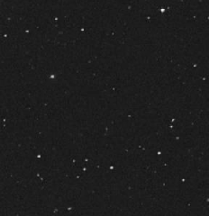
Types of Image Deconvolution Techniques
This leads us to a discussion of the array of image deconvolution techniques
Non-blind:
Identify the PSF separately from the blurred image – and apply the inverse to the blurred image.
Simplest to implement
These techniques use A Priori Blur Identification Methods
Require special knowledge of the PSF – using image features such as a point source (distant star) or feature edges to estimate the empirical PSF
similar approach to measuring the impulse response of a normal filter.
Emperical PSF

Slide 18
Types of Image Deconvolution Techniques
Blind Deconvolution:
Incorporating PSF and image identification (simultaneously estimating the PSF and true image)
More-complicated algorithms as a rule.
A variety of algorithm types have been developed:
Zero-sheet separation
Autoregressive Moving Average (ARMA) Paramter estimation
(Maximum likelihood estimation)
Non-parametric Deterministic Image Constraints Restoration Techniques (our focus here)
but also…

Slide 19
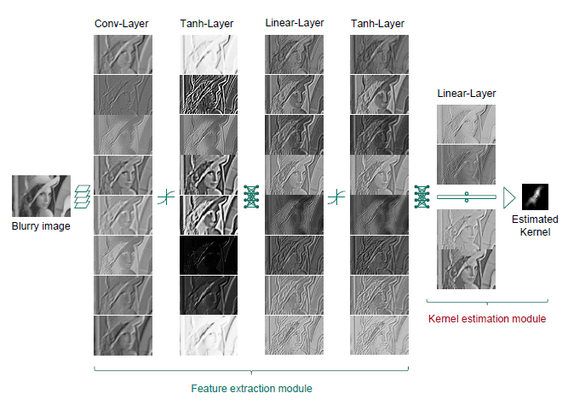
Types of Image Deconvolution Techniques
Neural-network implementations:
feature extraction is managed by different layers of the neural network.

Slide 20
Types of Image Deconvolution Techniques
Non-parametric Deterministic Image Constraints Restoration:
Lucy-Richardson Algorithm
Iterative Blind Deconvolution by Ayres and Dainty
Davey Algorithm (our focus here)
Simulated Annealing (SA) Algorithm – McCallum
Non-negativity and support constraint; recursive inverse filtering (NAS-RIF)

Slide 21
Blind Image Deconvolution: Davey Algorithm
Iterative algorithm for estimating the true image and PSF by applying deterministic constraints to the image and PSF.
An iterative algorithm takes an initial input, approximates the output and then feeds the approximation back in as an input and repeats to create a sequence of approximations that (hopefully) converge on the true solution/image.
To get the next iteration at each step, we need some a priori knowledge (filling the blanks) to be asserted on the image and PSF.
These are:
Non-negativity constraint Pixels can’t have negative values
Support constraint The true image is completely contained within a finite (bounded) support. The support is the smallest rectangle that contains the image.
Outside of the support, the image is uniformly black or white.
Finally, the Davey algorithm also involves, what is known as the Wiener constraint, the application of the wiener filter which has a number of useful properties, to be discussed shortly

Slide 22
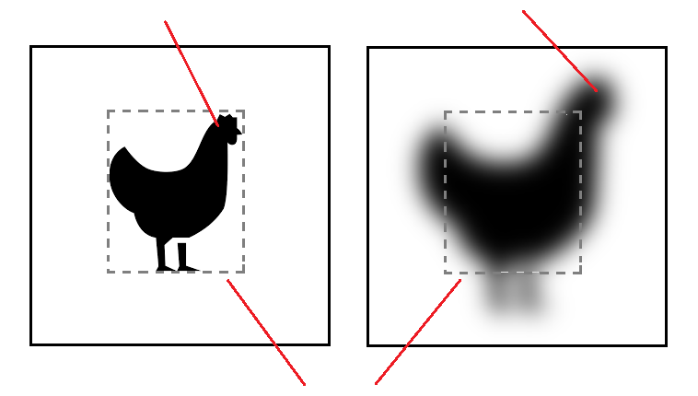
Blind Image Deconvolution: Davey Algorithm
Illustration of the support
Outline of blurred image
True Image
Image frame
Finite support of the true image

Slide 23
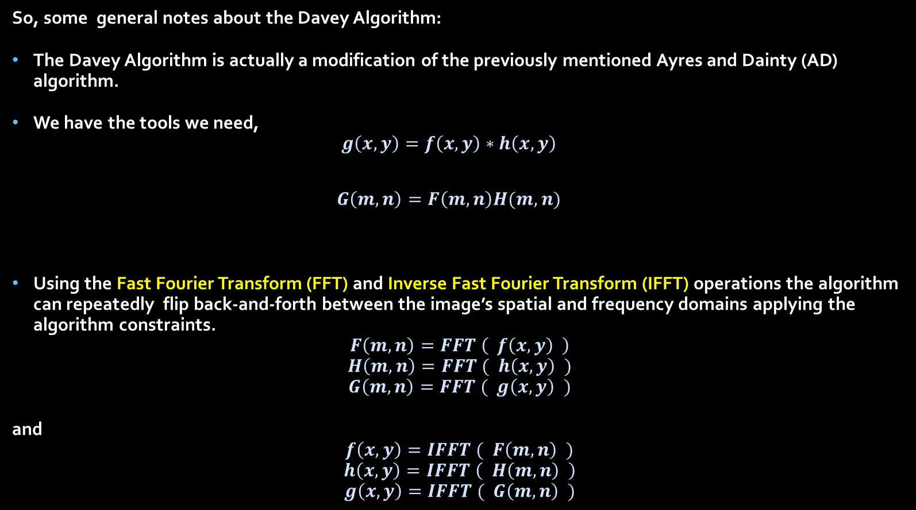
Blind Image Deconvolution: Davey Algorithm
So, some general notes about the Davey Algorithm:
The Davey Algorithm is actually a modification of the previously mentioned Ayres and Dainty (AD) algorithm.
We have the tools we need,
$$g\left(x,y\right)=f\left(x,y\right)∗h\left(x,y\right)$$
$$G\left(m,n\right)=F\left(m,n\right)H(m,n)$$
Using the Fast Fourier Transform (FFT) and Inverse Fast Fourier Transform (IFFT) operations the algorithm can repeatedly flip back-and-forth between the image’s spatial and frequency domains applying the algorithm constraints.
$$F\left(m,n\right)=FFT \left( f\left(x,y\right) \right)$$
$$H\left(m,n\right)=FFT ( h\left(x,y\right) )$$
$$G\left(m,n\right)=FFT ( g\left(x,y\right) )$$
and
$$f\left(x,y\right)=IFFT ( F\left(m,n\right) )$$
$$h\left(x,y\right)=IFFT \left( H\left(m,n\right) \right)$$
$$g\left(x,y\right)=IFFT ( G\left(m,n\right) )$$

Slide 24
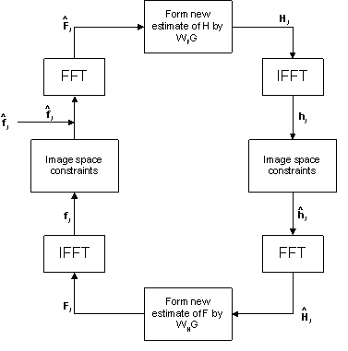
Blind Image Deconvolution: Davey Algorithm
Davey Algorithm flow diagram:
Initial image
estimate

Slide 25
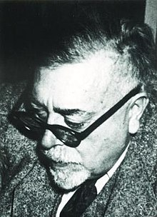
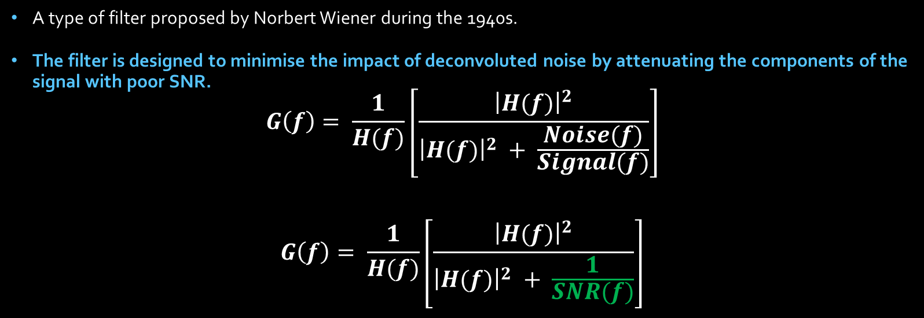
The Wiener Filter
A type of filter proposed by Norbert Wiener during the 1940s.
The filter is designed to minimise the impact of deconvoluted noise by attenuating the components of the signal with poor SNR.
$$G\left(f\right)= \frac{1}{H(f)}\left[\frac{{\left|H(f)\right|}^{2}}{{\left|H(f)\right|}^{2} + \frac{Noise(f)}{Signal(f)}}\right]$$
$$G\left(f\right)= \frac{1}{H(f)}\left[\frac{{\left|H(f)\right|}^{2}}{{\left|H(f)\right|}^{2} + \frac{1}{SNR(f)}}\right]$$
In the ideal case with infinite SNR,
the term in green becomes zero.
the square-bracketed term becomes 1.
the filter reduces to being the inverse of the system.
As SNR decreases,
the square-bracket term decreases.
attenuating the signal at those frequencies.

Slide 26
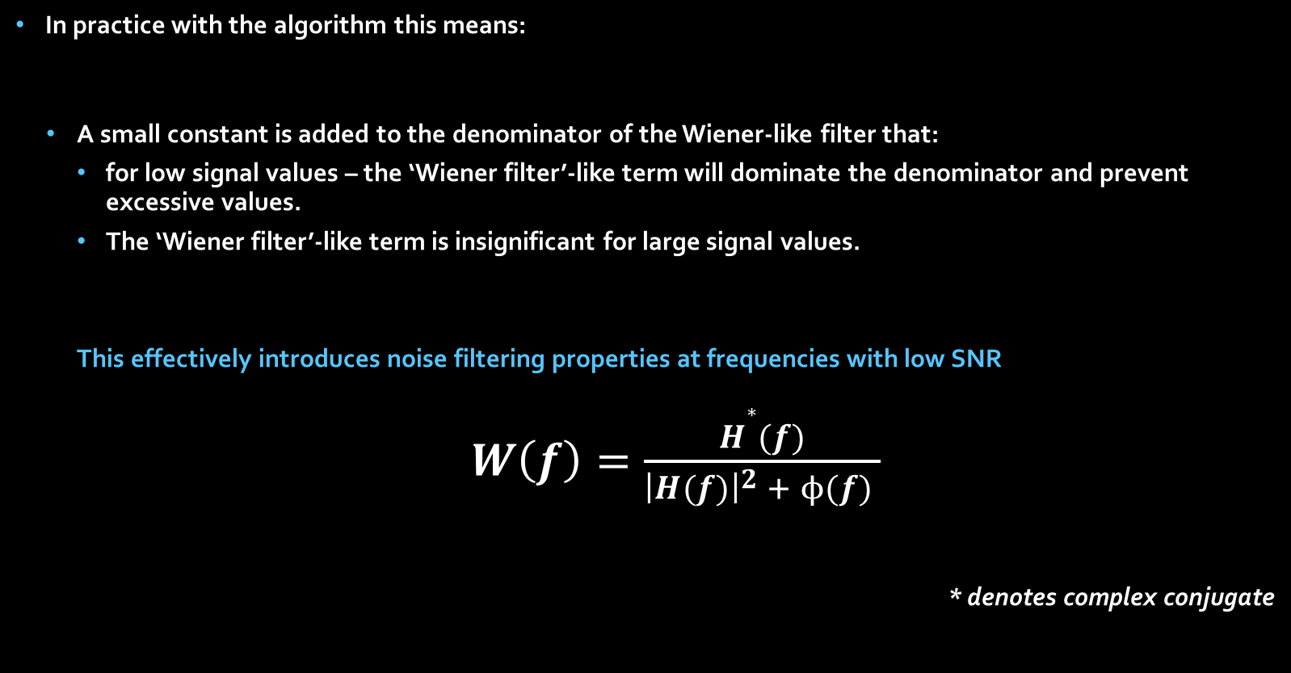
Blind Image Deconvolution: Davey Algorithm
In practice with the algorithm this means:
A small constant is added to the denominator of the Wiener-like filter that:
for low signal values – the ‘Wiener filter’-like term will dominate the denominator and prevent excessive values.
The ‘Wiener filter’-like term is insignificant for large signal values.
This effectively introduces noise filtering properties at frequencies with low SNR
$W\left(f\right)=\frac{H∗(f)}{{\left|H(f)\right|}^{2} + ϕ(f) }$
* denotes complex conjugate

Slide 27


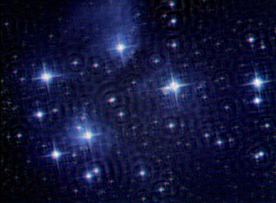
Blind Image Deconvolution: Results
some examples of the results:

Slide 28
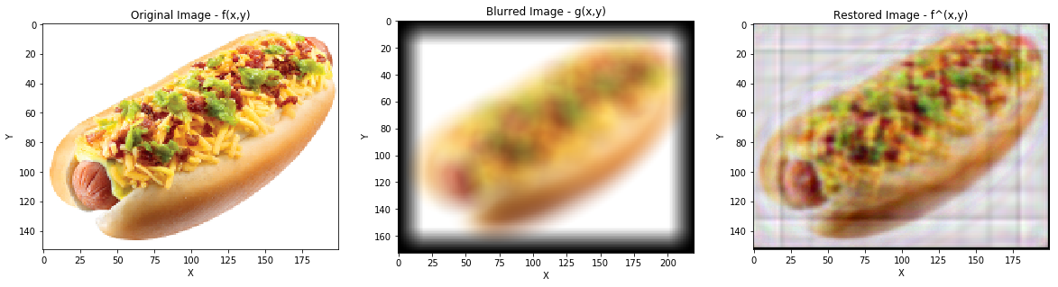
Blind Image Deconvolution: Results
some examples of the results:

Slide 29
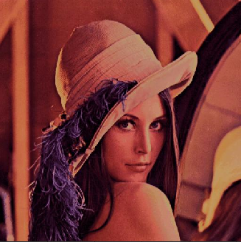

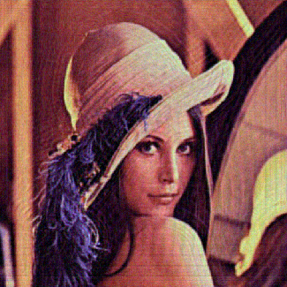
Blind Image Deconvolution: Results
some examples of the results:
True image
Degraded image
Restored image
3242 iterations

Slide 30
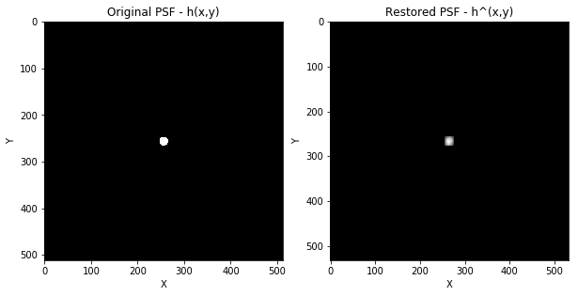
Blind Image Deconvolution: Results
some examples of the results:
True PSF
Restores PSF
3242 iterations

Slide 31
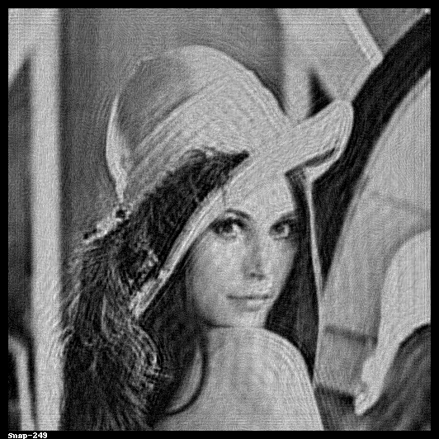
Blind Image Deconvolution: Results
Some examples of the results:
3242 iterations

Slide 32
Blind Image Deconvolution: Davey Algorithm
Algorithm Summary
Pros
The Davey IBD algorithm is popular because:
It is computationally inexpensive.
Can be modified to include support for:
Different assumptions about the true image and PSF.
Differences in how the assumptions are imposed in the image and Fourier domains.
Extensions for scenarios where multiple degraded images are available for the same true image.
Robustness to noise due to the Wiener filtering nature:
Suppresses noise amplification at frequencies with poor SNR
Combats the ill-posed nature of the problem where high frequency components of the blur function are greatly amplified, resulting in the amplification of noise at those frequencies.

Slide 33
Blind Image Deconvolution: Davey Algorithm
Algorithm Summary
Cons
Lack of reliability
Uniqueness and convergence properties of the algorithm are currently uncertain.
Restoration performance is sensitive to the initial image estimate
Small differences in initial estimate can produce wide variance in the final result.
Algorithm can exhibit instability.
Gibbs oscillations introduced near image boundaries
These can be combatted using image processing techniques … but that’s a story for another day.

Slide 34
Blind Image Deconvolution: Davey Algorithm
References
J. Hong
“Refinements in Iterative Blind Deconvolution”
Thesis (Ph.D.), University of Canterbury, New Zealand, 1995
A. Liu
“Blind Image Deconvolution”, June 2014
http://www.dartmouth.edu/~aron/Image%20Deconvolution%20-%20Aron%20Liu.pdf
P. Campisi and K. Egiazarian
“Blind image deconvolution: Theory and applications”
http://www.dbabacan.info/papers/Campisi_Egiazarian_BIDmain_FOR_CH1.pdf
Optics Letters, vol.13, no.7, July 1988.

Slide 35
Blind Image Deconvolution: Davey Algorithm
References
D. Kundur and D. Hatzinakos
“Blind image Deconvolution”
IEEE Signal Processing Magazine, May 1996
G. R. Ayers and J. C. Dainty,
“Iterative blind deconvolution method and its applications”
Optics Letters, vol 13, no. 7, July 1988

Slide 36
Thank you for your attention!

